Slide 1
Edge Fundamentals
Anatomy of an Edge Proxy

Slide 2
Your Objectives…
Define proxy components with Apigee Edge
Create your first Apigee proxy

Slide 3
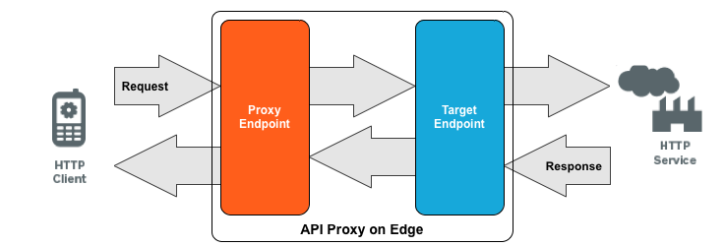
Two Sides to Every Story
Defines proxy URL & HTTP vs. HTTPS access
Defines forwarding and connection Info.
Proxy Endpoint - policies for the request and response to the client
Target Endpoint - policies for the request and response to the backend target server
Attach policies for security, quota, rate limiting, etc.
Attach policies to ensure proper response message formatting
Notes:
ProxyEndpoint: Defines the way client apps consume your APIs.
Configure the ProxyEndpoint to define the API proxy URL. It also determines either HTTP or HTTPS access to the API proxy.
You usually attach policies to the ProxyEndpoint to enforce security, quota checks, and other types of access control and rate-limiting.
TargetEndpoint: Defines the way the API proxy interacts with your backend services.
Configure the TargetEndpoint to forward requests to the proper backend service, including defining any security settings, HTTP or HTTPS protocol, and other connection information.
You can attach policies to the TargetEndpoint to ensure that response messages are properly formatted for the app that made the initial request.

Slide 4
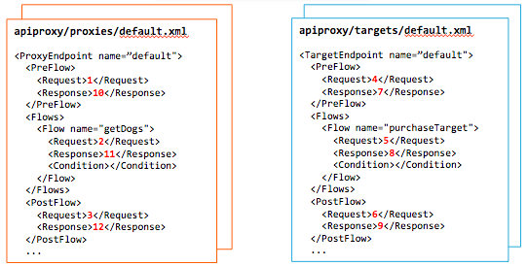
Proxy Flow and Endpoints
1
4
2
5
3
6
10
7
11
8
12
9
13
Notes:
Show/talk about the numbers on the map.
Proxy endpoints are like the US Marines: first one in, last one out.
Within each endpoint are flows, Pre-flow, conditional flows, and post-flows.
PreFlow: Always executes before any conditional Flows.
Conditional Flows: One or more Flows, each of which has an associated Condition. Only one conditional Flow executes per transaction--the first Flow whose Condition evaluates to true.
PostFlow: Always executes after any conditional Flows.
PostClientFlow: An optional Flow that executes after the response message has been sent to the requesting client app. (This is a specialized Flow, and only MessageLogging policies can be attached to it.)

Slide 5
Anatomy of an API Proxy
Platform Entities
Organizations, Environments and Proxies
Proxy Endpoint
Fault Rules
Virtual Hosts
Flows
PreFlow
Conditional Flow
PostFlow
Connection
RouteRules
Target Endpoint
Fault Rules
Virtual Hosts
Flows
PreFlow
Conditional Flow
PostFlow
Connection
RouteRules
Load balancing
Notes:
After you create an API proxy on Edge, the default URL that an app uses to access the proxy has the form:
http://{org-name}-{env-name}.apigee.net/{base-path}/{resource-path}
https://{org-name}-{env-name}.apigee.net/{base-path}/{resource-path}
where:
{org-name} is your organization name. This name is created when you create an account on Edge.
{env-name} is the Edge environment name. By default, all Apigee organizations created in the cloud are provisioned with two environments: 'test' and 'prod'. When deploying an API proxy, you can choose to deploy it to one or both environments.
{base-path} and {resource-path} are defined when you create the API proxy.
When a request comes in to Edge, Edge parses the URL to direct the request to the correct ProxyEndpoint. For example, the following URL is used to access an API proxy on Edge:
http://myOrg-prod.apigee.net/v1/weather/forecastrss

Slide 6
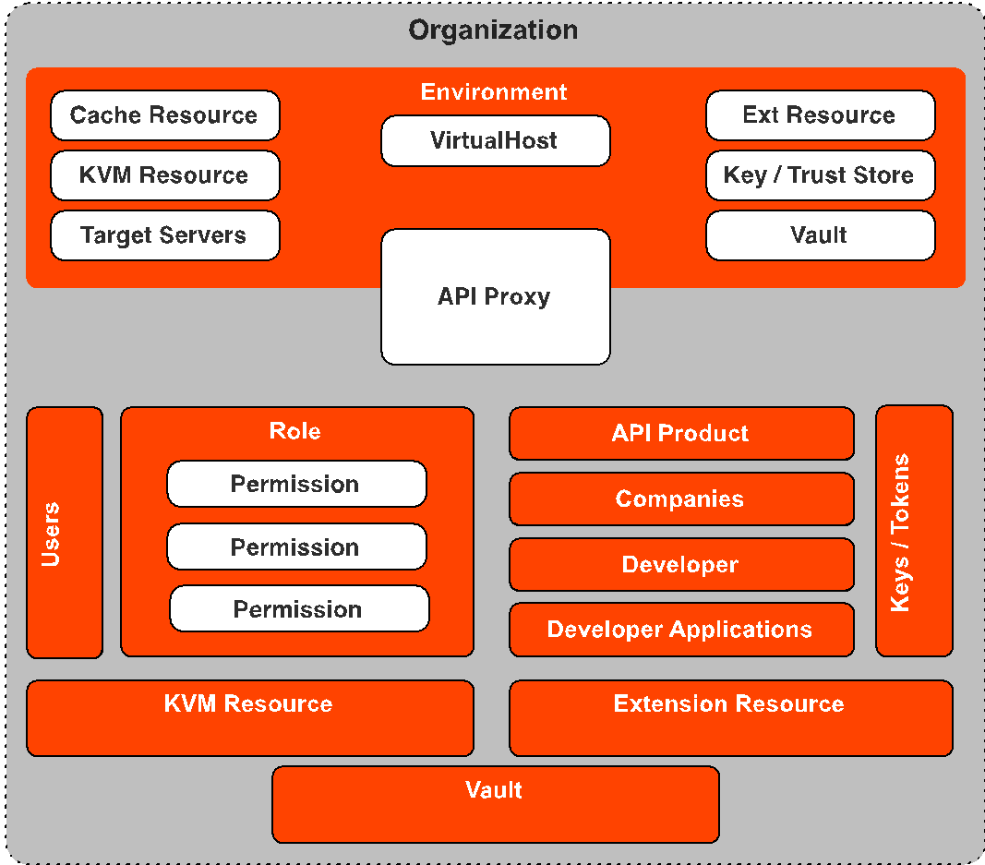
Platform Entities
Notes:
Also encourage the class to read up on their own for further details:
But Before we dive into the anatomy of an API Proxy we need to understand where proxies live on the platform.
The Edge platform is a built as a multi-tenet platform that hosts in the cloud or a Private cloud a customer proxy platform. That Platform is made of some core components.
First Component of Note: Organization
Organizations are important because they define the platform. Every other component lives either directly in an organization or in a component that lives in an organization. Organizations ultimately give you a logical barrier around your platform logical components. No two organizations share logic components.
Now lets go over the organizations components:
Environments live within organizations and are primarily used to manage the deployed state of your proxy. For instance if i had a test, prod environment i could deploy my proxy to either or both environments. Environments may contain a series of resources that are used by your proxy. eg. Virtual Hosts, Target Servers, Cache Resources, Extension Resources, KeyStore's and Trustores and Vault.
Also living at the Organization level is all of the user management elements used to manage access to resources. User management is composed of three components starting with Users who are assigned a Role, (the second) which contains a series of Permissions.
API management is a key focus for an api proxy and the resources needed for API management are stored at the Organization level, for instance API Products ,Companies, Developers and Developer Applications. And because of this keys and tokens are also stored within the organization.
Note: Although they API products are stored at the organization, they can be scoped to a particular environment or API Proxy.
Discussion Notes: This topic often leads to Organization vs. Environment strategies
Also like the environment KVM Resources, Extension Resources and Vaults can also be stored at the organization level.

Slide 7
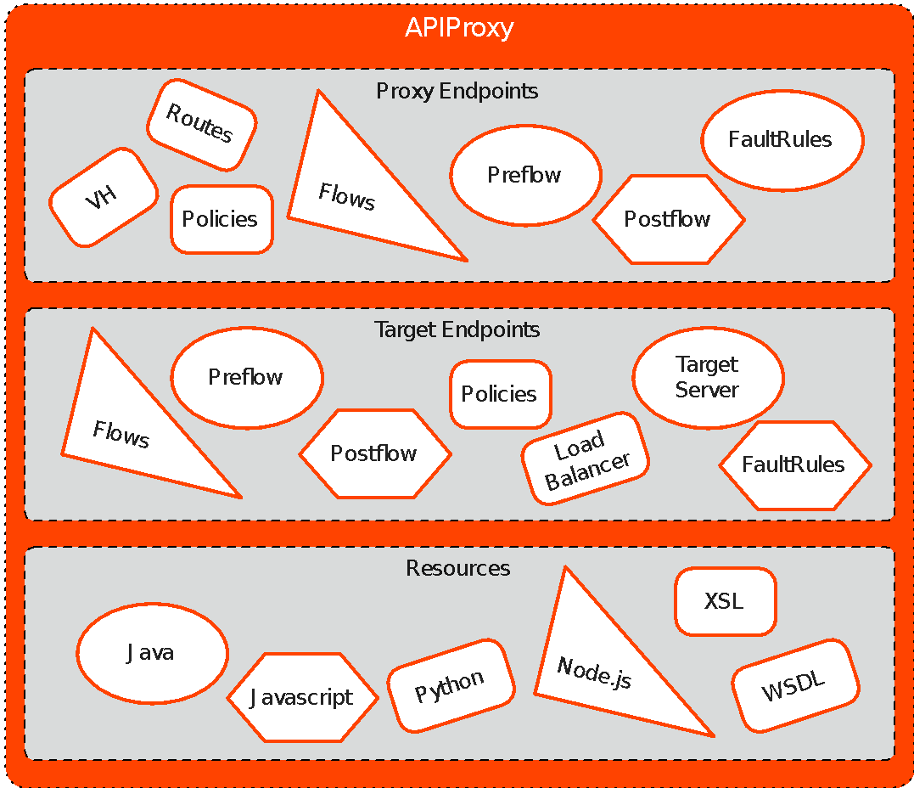
API Proxies
Proxy Endpoint
1
2
3
Target Endpoint
Scripting Resources
Notes:
An Api Proxy is composed of 3 primary components
The First is the Proxy Endpoint
The second is the Target Endpoint
Third is your Scripting Resources
Now lets break each one of these components into their separate parts

Slide 8
Quick Knowledge Check
In which flow do policies that secure an API belong?
Proxy Endpoint Request PreFlow
Proxy Endpoint Request postflow
Target Endpoint response preflow
Target Endpoint request preflow
In which flow do policies that transform the backend’s response to what the client expects belong?
Proxy endpoint response preflow/postflow
Target endpoint response preflow/postflow
Proxy endpoint response postflow
Proxy endpoint response conditional flow
Valid answer
best answer: could be multiple backends with different transformation requirements

Slide 9
Quick Knowledge Check
A Conditional Flow allows you to…
Execute only at the target endpoint
Craft highly specialized processing rules for request or response message that meet certain criteria
Create standard rules across different proxies
Which flow is a good place to log data?
Postflow
Preflow
Conditional flow
Main flow

Slide 10
Quick Knowledge Check
On the Proxy Endpoint Preflow, which would be the correct order of policies listed below?
Authorization policy, Message validation, authentication, quota
Message validation, authentication, Authorization, quota
Quota, Authorization, Message validation, authentication
Authorization policy, spike arrest, quota, message validation
Which policy would make sense for users on mobile devices (for formatting response)?
Caching
Concurrent rate limit
Message validation flow
Xml-to-json

Slide 11
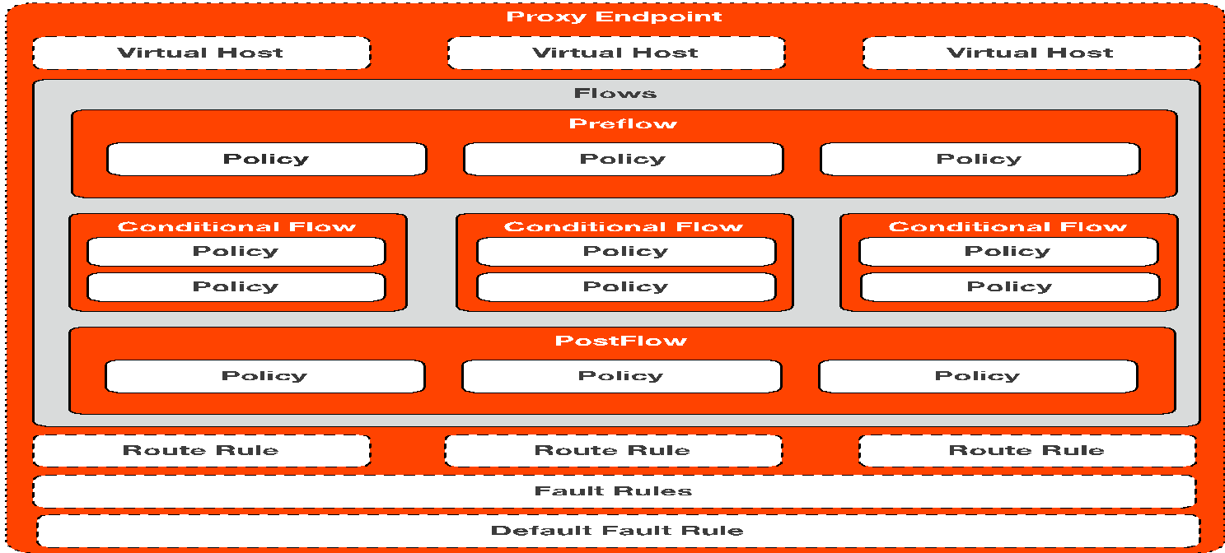
Proxy Endpoint
Request
PreFlow
Conditional Flows
PostFlow
Response
PreFlow
Conditional Flows
PostFlow
Notes:
A virtual host on Edge is your domain url (url to call) & (mapped to backend), port # is port apigee is listening to.
A virtual host also defines whether the API proxy is accessed by using the HTTP protocol, or by the encrypted HTTPS protocol.
Flows: PreFlow, PostFlow, Conditional Flow.
Route Rules – determine the path of a request from ProxyEndpoint to TargetEndpoint
Fault Rules – Like exceptions in programming. You can replace default cryptic error messages with more useful custom messages.
Default Fault Rule - Handles generic errors in your API and acts an exception handler for any error that is not explicitly handled by another FaultRule. You can force this to appear even if another fault rule/condition happens.

Slide 12
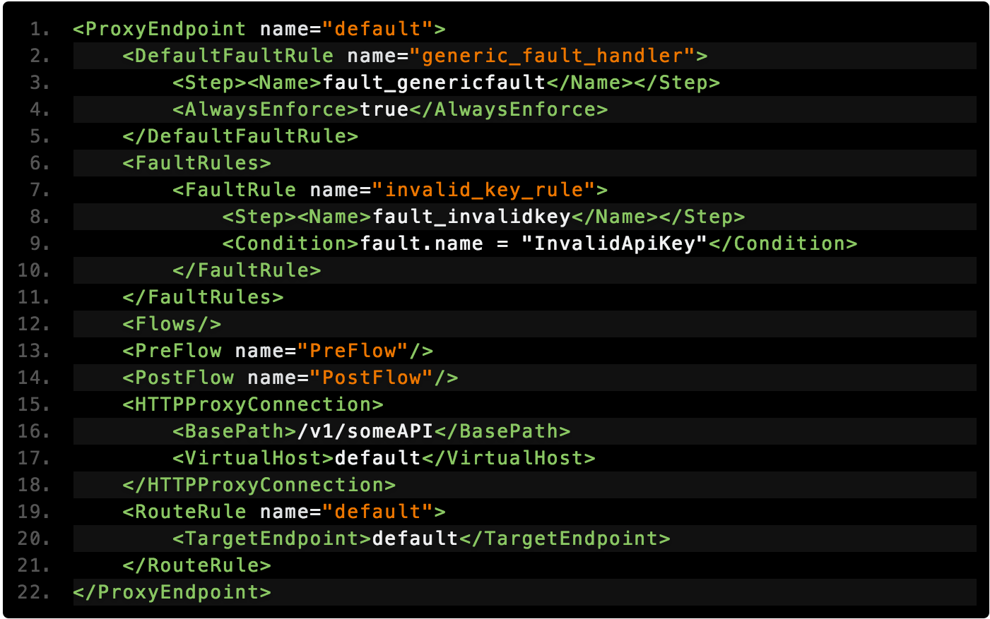
Proxy Endpoint Example
Notes:
Lets look at what a proxy looks like in a simple form. One of the key configuration points for your proxy resides in the HTTP Connection tag, were we configure the base path and the virtual hosts.
The basepath is very important since it needs to be unique across all your proxies When building your proxy there is not specific order the root level tags need to be in.

Slide 13
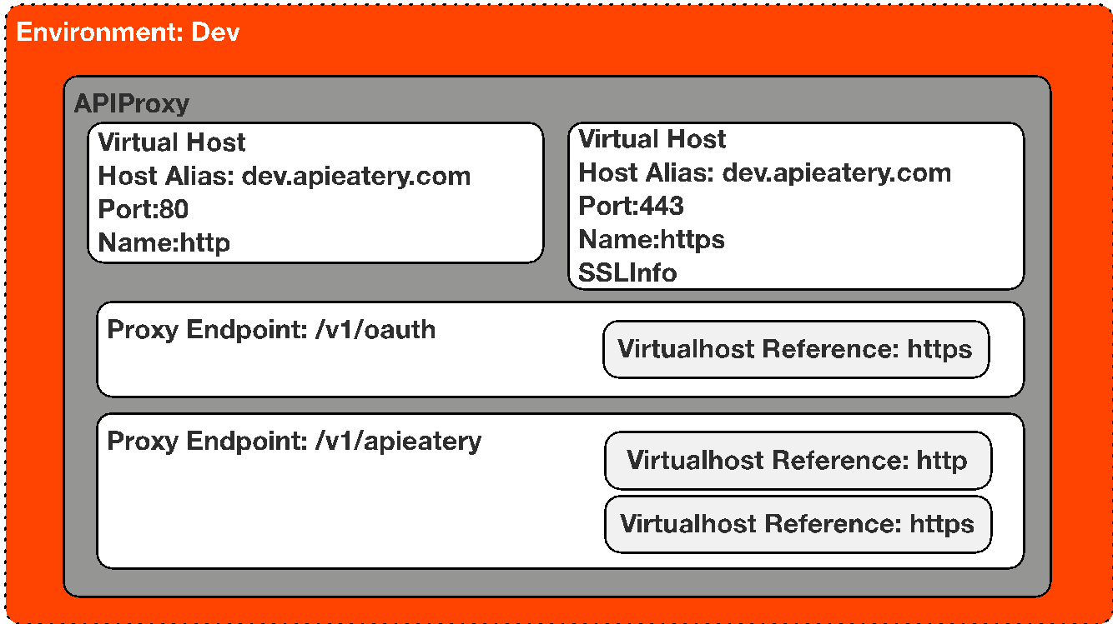
Virtual Hosts
Notes:
Virtual Host configs should live outside of the API proxy, and they let multiple domain names connect to the same host.
A virtual host on Edge defines the domains and Edge Router ports where an API proxy is exposed, and, by extension, the URL that apps use for access.
A virtual host also defines HTTP or HTTPS protocol
A environment can contain multiple virtual hosts and a proxy’s client side endpoint is configured to listen on one or more virtual hosts. The virtual host’s configuration determines how an API request will route into an API proxy

Slide 14
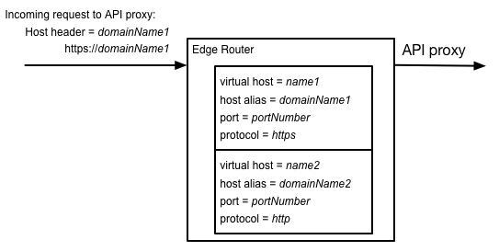
Virtual Hosts
In Edge, a Router handles all incoming API traffic. Therefore, API proxy requests must be directed to the IP address and open port on a Router.
A virtual host on Edge defines a protocol (HTTP or HTTPS), along with a Router port and a host alias. The host alias is typically a DNS domain name that maps to a Router's IP address.
For example, the following image shows a Router with two virtual host definitions:

Slide 15
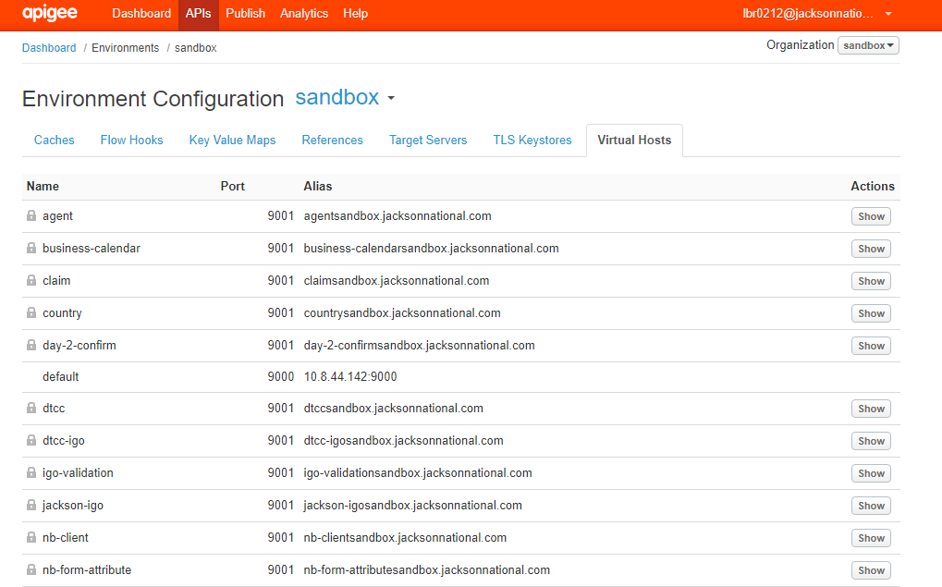
Virtual Hosts
Notes:
Show the Virtual Hosts config in the API sandbox

Slide 16
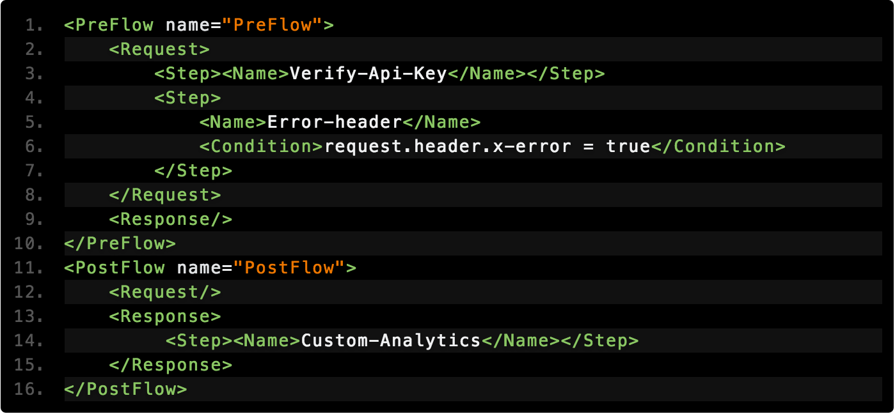
Policy Flows
Global Flows
Notes:
Walkthrough the structure of the XML Spend a little time talking about PostClientFlow.. And make sure you mention that only Message Logging Policies can be executed in that flow.

Slide 17
Policy Flows
Conditional Flows / Resource
Post Client
Notes:
A “Conditional Flow” is a collection of policies within the API Flow that all share one rule. All policy attachments in the Preflow execute first, then the first matching Conditional Flow execute, then everything in the Postflow executes. This happens on the Proxy Request, then the Target Request, and repeats back through the Target Response and the Proxy Response.

Slide 18
Policies
Notes:
Edge enables you to 'program' API behavior without writing any code, by using 'policies'. A policy is like a module that implements a specific, limited management function. Policies are designed to let you add common types of management capabilities to an API easily and reliably. Policies provide features like security, rate-limiting, transformation, and mediation capabilities, saving you from having to code and maintain this functionality on your own. Edge Policy types are grouped into the following functional categories:
Traffic management Policies in the traffic management category enable you to control the flow of request and response messages through an API proxy. These policies support both operational- and business-level control. They give you control over raw throughput, and can also control traffic on a per-app basis. Traffic management policy types enable you to enforce quotas, and they also help you to mitigate denial of service attacks.
Mediation Policies in the mediation category enable you to actively manipulate messages as they flow through API proxies. They enable you to transform message formats, from XML to JSON (and vice-versa), or to transform one XML format to another XML format. They also enable you to parse messages, to generate new messages and to change values on outbound messages. Mediation policies also interact with basic services exposed by API Services, enabling you to retrieve data about apps, developers, security tokens, and API products at runtime.
Security Policies in the security category support authentication, authorization, as well as content-based security. Extension Policies in the extension category enable you to tap into the extensibility of API Services to implement custom behavior in the programming language of you choice. Each Policy type is documented in detail in the Policy reference overview. This topic demonstrates general interaction, showing you how to create Policies, and how to attach them to Flows in an API proxy configuration.

Slide 19
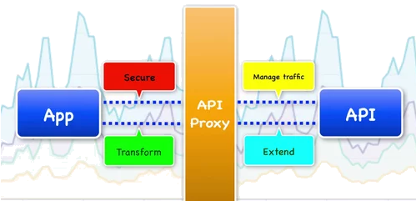
Policies on Endpoints
Proxy Endpoint
Target Endpoint
Attach policies to the ProxyEndpoint to:
enforce security, quota checks, and other types of access control and rate-limiting
Attach policies to the TargetEndpoint to:
ensure that response messages are properly formatted for the app that made the initial request
Proxy Endpoint
Target Endpoint

Slide 20
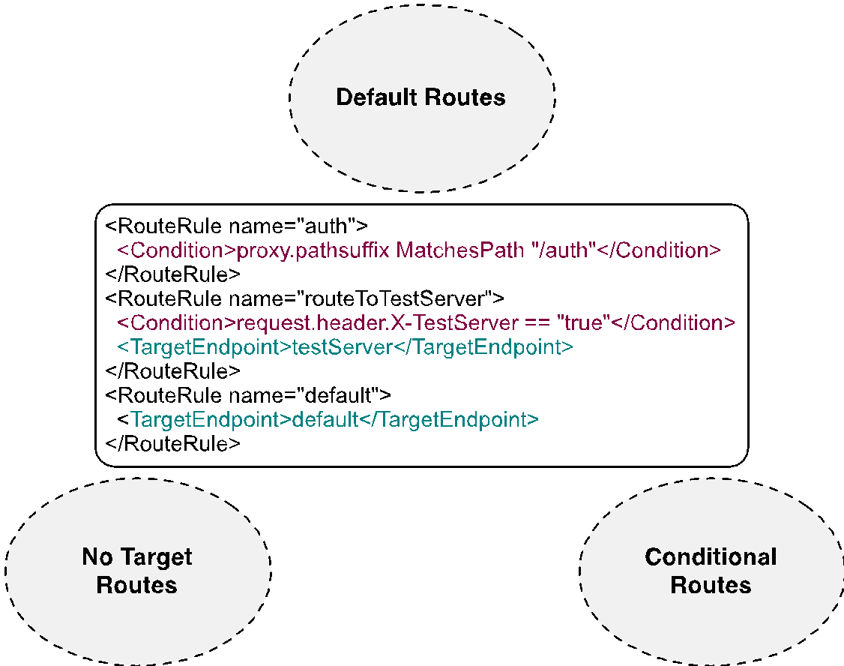
Route Rules
Notes:
Target is determined by RouteRules One or more RouteRule sections are placed at the bottom of the proxy definition file (proxies/{proxy}.xml) within ProxyEndpoint RouteRules are evaluated top to bottom, taking first match only.

Slide 21
Jackson Route Rules
Default Routes
<RouteRule name="validate-funds">
<Condition>(proxy.pathsuffix MatchesPath "/validate-funds") and (request.verb = "POST")</Condition>
<TargetEndpoint>validate-funds</TargetEndpoint> </RouteRule>
No Target Routes
Conditional Rules
Notes:
Target is determined by RouteRules One or more RouteRule sections are placed at the bottom of the proxy definition file (proxies/{proxy}.xml) within ProxyEndpoint RouteRules are evaluated top to bottom, taking first match only.

Slide 22
Jackson Route Rules
Default Routes
<TargetEndpoint>*.js</TargetEndpoint>
Ex. calls .js file for Country Codes
No Target Routes
Conditional Rules
Notes:
Target is determined by RouteRules One or more RouteRule sections are placed at the bottom of the proxy definition file (proxies/{proxy}.xml) within ProxyEndpoint RouteRules are evaluated top to bottom, taking first match only.

Slide 23
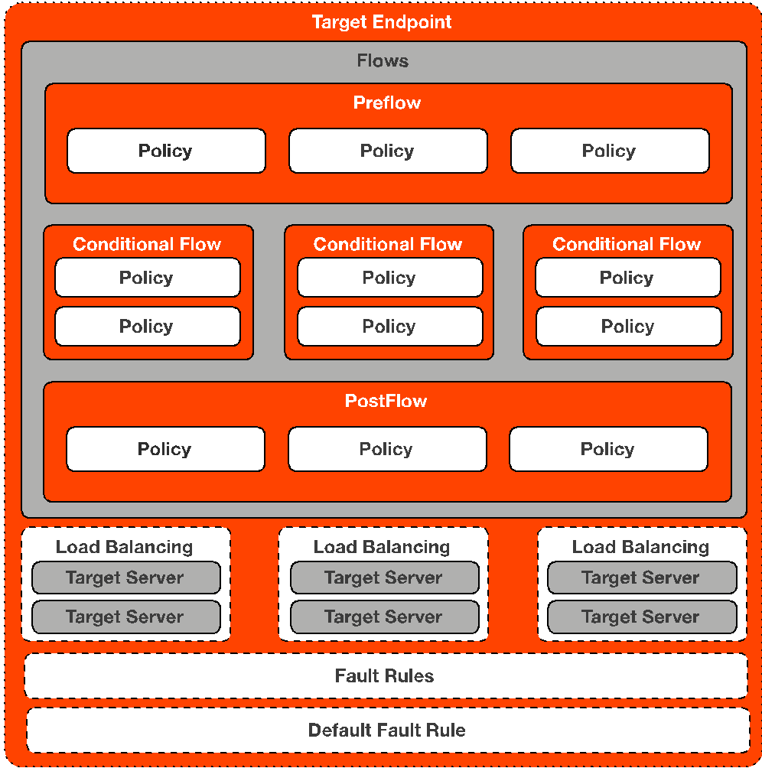
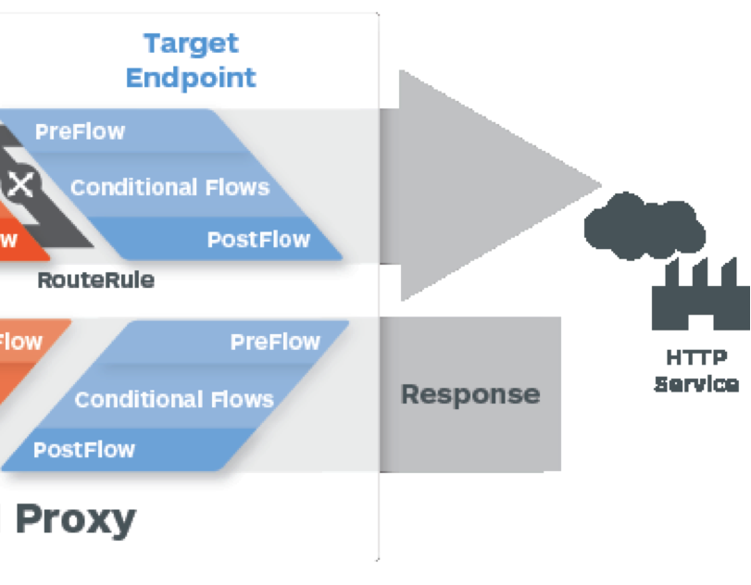
Target Endpoint
Forwarding requests to the proper backend service
Notes:
Defines the way the API proxy interacts with your backend services. You configure the TargetEndpoint to forward requests to the proper backend service, including defining any security settings, HTTP or HTTPS protocol, and other connection information.

Slide 24
Target Endpoint Example
Notes:
Review The Target Endpoint's Basic Features, point out its basic structure and its similarities to the Proxy Endpoints

Slide 25
Fault Rules (Exceptions)
Notes:
AlwaysEnforce = true means that the default fault rule will display even if another fault is also matched. hi
Faults in Edge are similar to exceptions in programming languages. When a fault is raised, current policy processing is aborted and switches to error processing called FaultRules. This is supported in ProxyEndpoint and TargetEndpoint configurations only Support for multiple fault rules, executed conditionally Raised manually or automatically upon policy failure If multiple conditional FaultRules defined, their conditions are evaluated in reverse order (bottom up). DefaultFaultRule A catch-all / post processing fault rule is available using the flow If no FaultRule is matched, this flow will execute. Use AlwaysEnforce:true to use this flow for post processing in error flows. This will ensure the flow executes after a matched fault rule has completed its processing. 3 scenarios where processing will switch to fault processing: Using RaiseFault policy Any policy failure when contineOnError=false (default setting) Non-success response received from service callout or backend request (4XX, 5XX status codes).

Slide 26
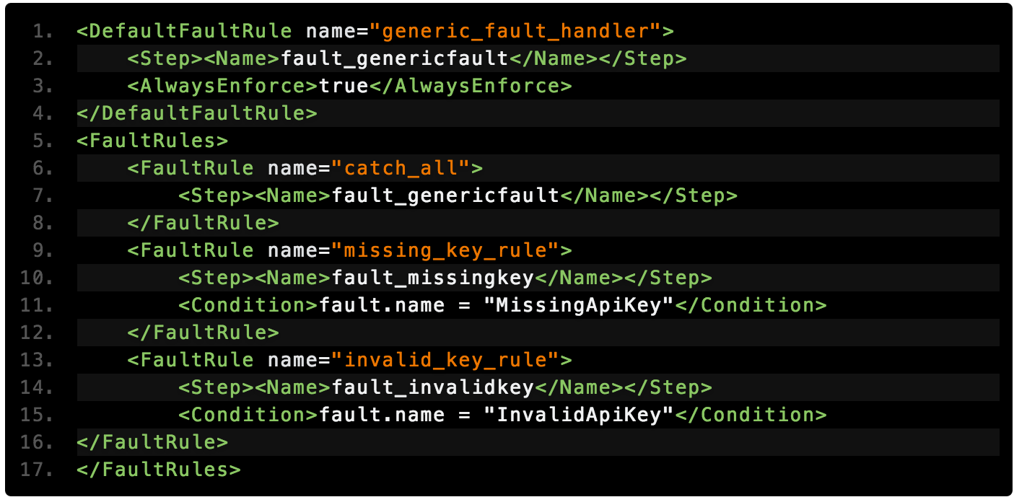
Fault Rules

Slide 27
Labs
Lab 01a: Deploy a proxy to Test environment
Test environment
Lab 2a: Change target backend
Change the current target server to a new server (hint: coding required!)
Lab 2b: Add policy to your proxy
We want to change the output of your response to the requester

Slide 28
Debrief Labs
What did we do?
How should it look?

